Slide 1
CMSD CREDIT RECOVERY PROGRAM
Alicia Moore, Project Manager

Slide 2
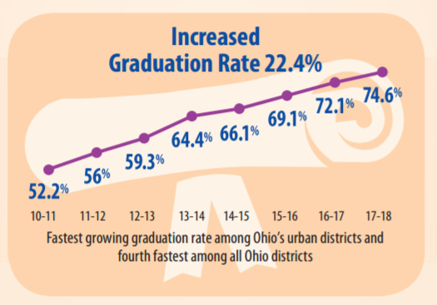
CMSD GRADUATION RATE Based on 2018 State Report Card
Retrieved from clevelandmetroschools.org

Slide 3
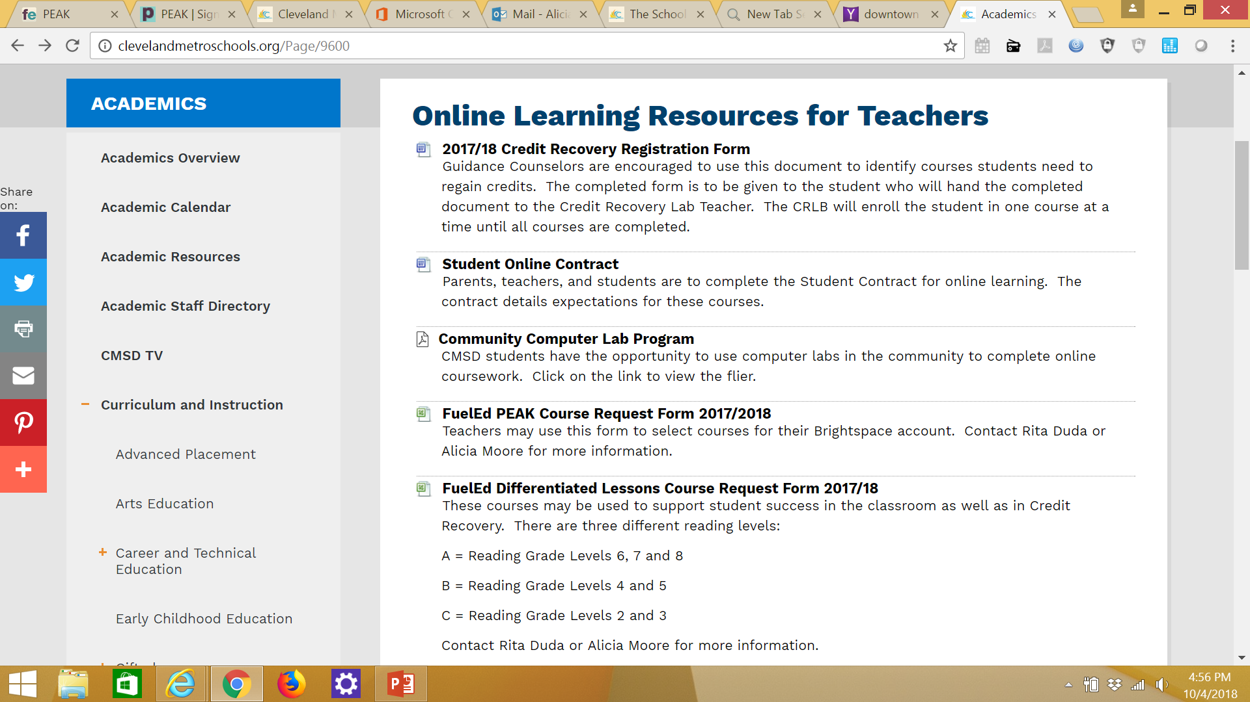
Online Resources
http://clevelandmetroschools.org/Page/9600

Slide 4
Credit Recovery Form
Differentiated Lessons
Determine Level
Enrollment
CR Courses
Enrollment
Contact Alicia Moore
THE
CREDIT RECOVERY PROCESS
No Course

Slide 5
Differentiated Lessons
Designed for students identified with IEPs, 504 Plans, ELL, or ESL who need Credit Recovery.
CR Lab Teacher must confer with Intervention Specialist prior to enrolling student into Differentiated Lessons.
Instructor-of-record must be certified/ licensed in the content area of course student being enrolled.
Can be used in the classroom to support student learning.
Content can be modified.

Slide 6
EXAMPLES OF DATA WALLS

Slide 7
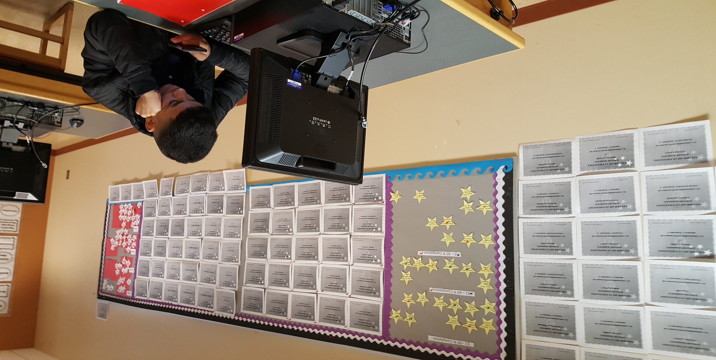
EXAMPLES OF DATA WALLS

Slide 8
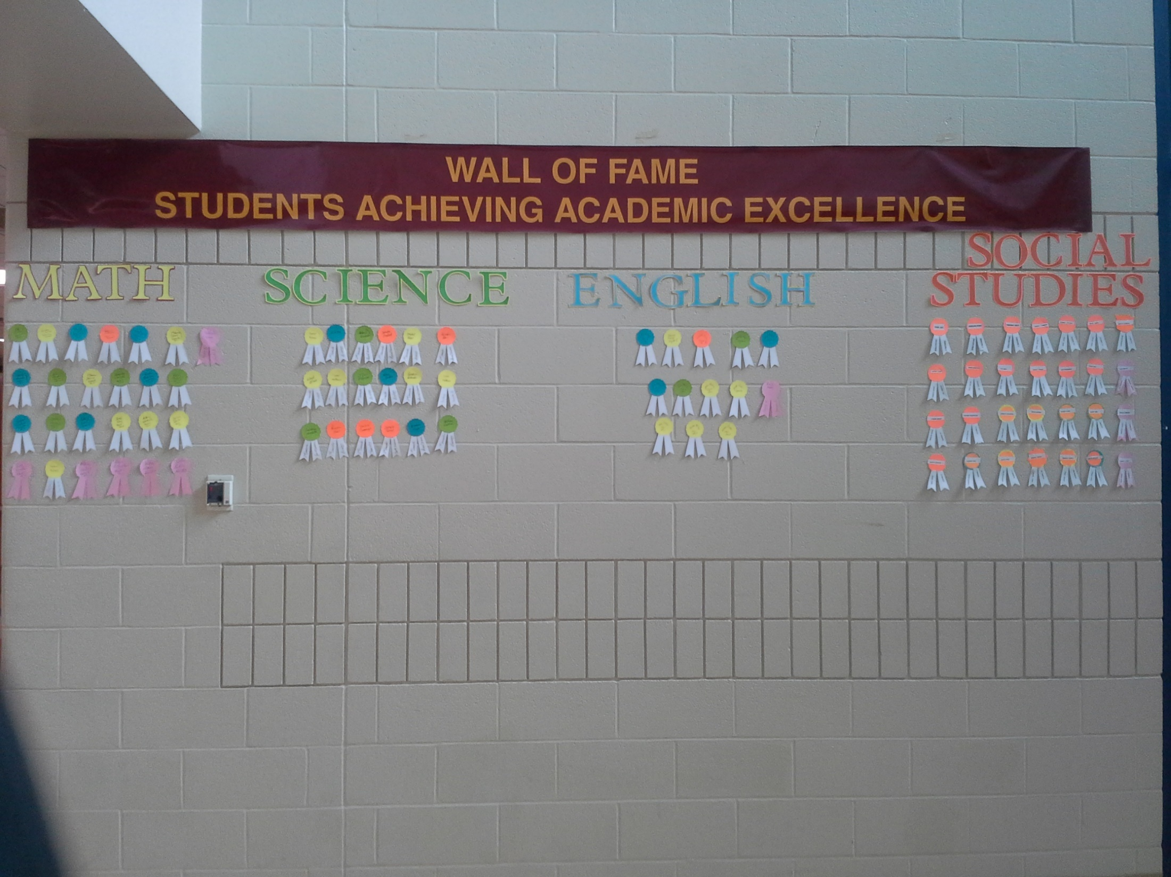
COURSE COMPLETION DATA WALL

Slide 9
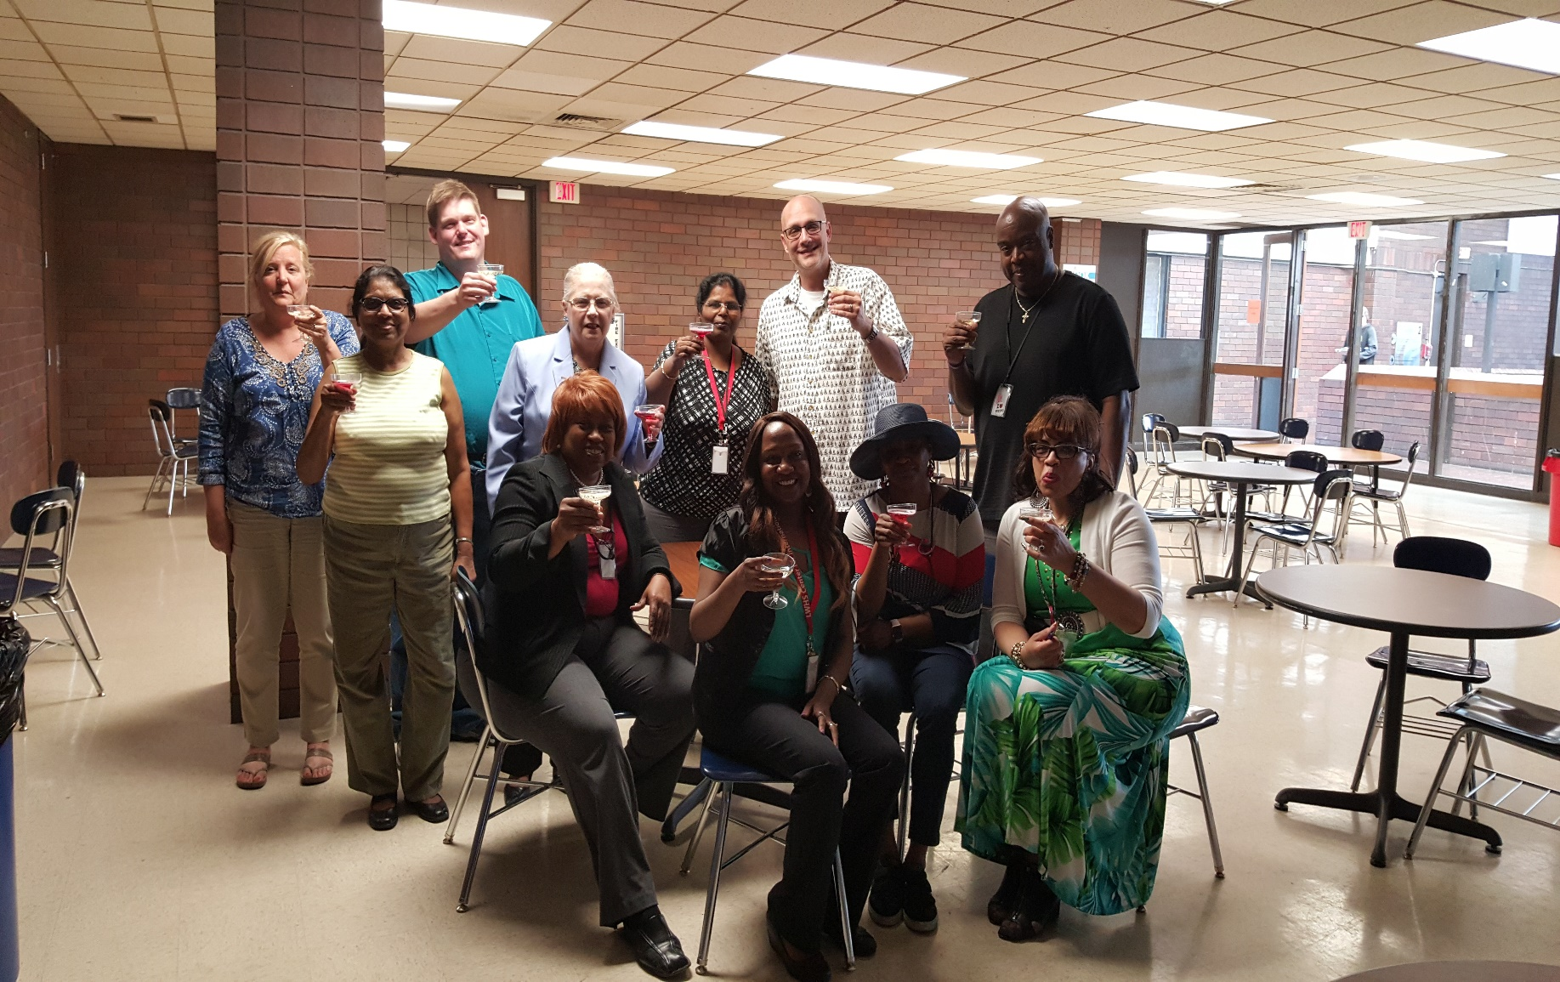
CELEBRATING SUCCESS

Slide 10
CONTACT INFORMATION
ALICIA MOORE: Alicia.moore@clevelandmetroschools.org
(216) 838-0167

